Slide 1
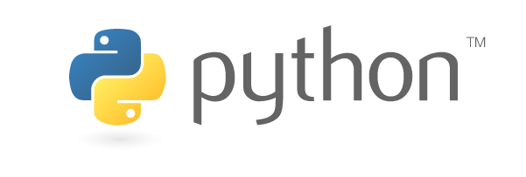
FAIM Python Course – Session 1
Introduction for Beginners
benjamin.titze@fmi.ch
Facility for Advanced Imaging and Microscopy (FAIM)
21 October 2020

Slide 2
Python is a…
general-purpose
interpreted
high-level
object-oriented
… programming language.

Slide 3

A brief history of Python
Started out as a ‘hobby programming project’ to bridge the gap between shell scripts and C. Named after the British comedy group ‘Monty Python’, but the logo is inspired by the snake.
Now developed and maintained by a large international community. Python Foundation (governance, releases, documentation): https://www.python.org
Python 1.0 – 1994
→ 1.x versions are obsolete
Python 2.0 – 2000
→ Latest and final: 2.7 in 2010
Python 3.0 – 2008
→ Currently 3.9 (October 2020)
Maintenance of Python 2 has stopped in 2020.
Python 3 is the future. Don’t start new projects with Python 2!
Created by Guido van Rossum
at CWI, Amsterdam. First
release in 1991. Van Rossum
was Python’s ‘Benevolent
Dictator for Life’ until 2018.

Slide 4
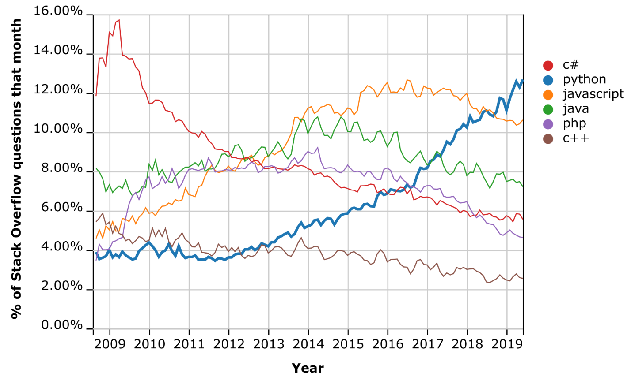
Python has become a mainstream programming language
Easy to learn and use, great community and open-source ecosystem (over 250,000 packages available as of 2020!).
It’s free forever (unlike proprietary software such as MATLAB, LabVIEW, …).
Increasing use by large tech companies: Google, Amazon, Instagram, Dropbox, Spotify, Netflix…
… and it’s the most popular choice for machine learning applications.
Among major programming languages, Python has seen the fastest growth over the past decade. See also https://tiobe.com/tiobe-index/

Slide 5
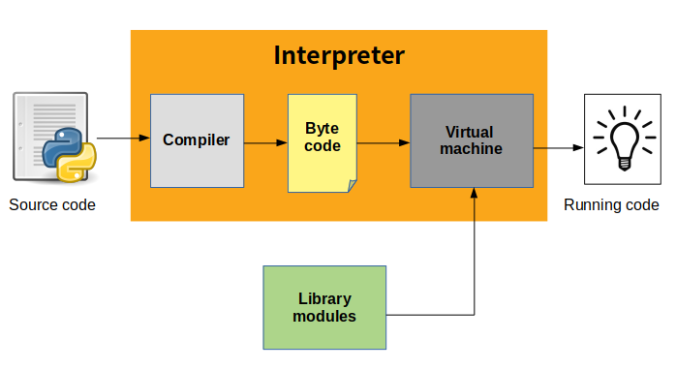
From source code to execution
The source code (*.py files) is first compiled into byte code (*.pyc files), an intermediate lower-level language for faster execution (but much slower than machine code).
Byte code is run on the Python Virtual Machine.
CPython is Python’s open-source reference implementation.
Source: https://indianpythonista.wordpress.com

Slide 6
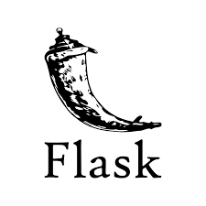

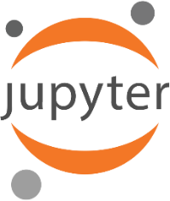
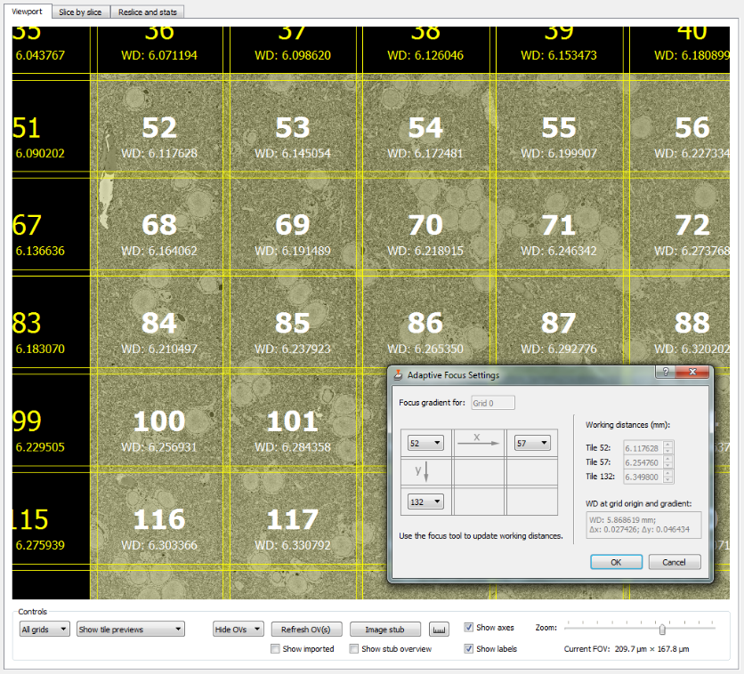
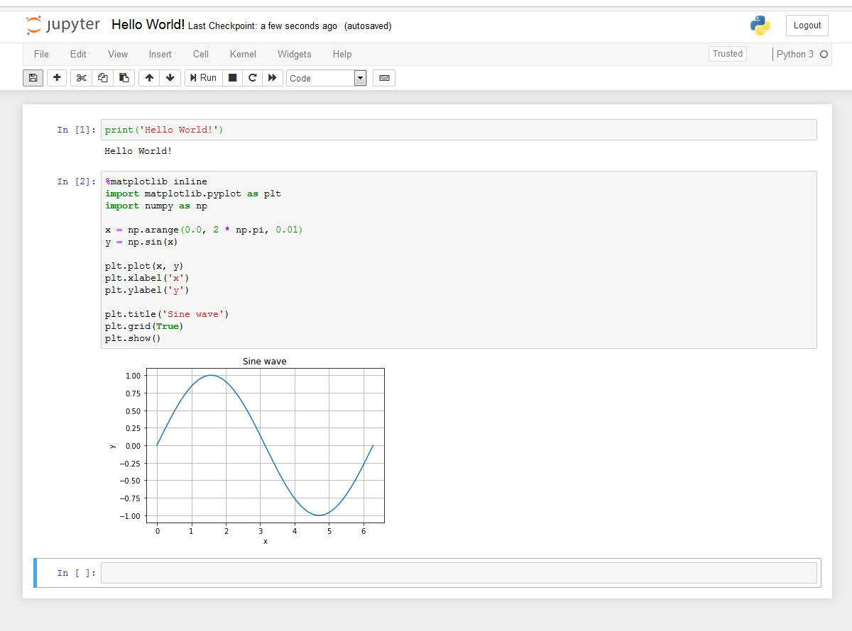
How Python is commonly used
Python programs (usually tools)
that are run from the command line/ terminal/shell/console:
No graphical user interface, only text.
Web development with frameworks such as Django and Flask
Jupyter Notebook:
A browser-based inter-active programming environment (Julia, Python, R), ideal for
data analysis and visualization.
GUI (Graphical User Interface)-based applications (with PyQt, for example)

Slide 7
We will use Jupyter Notebook for this session
Run from command line / Anaconda Prompt:
jupyter notebook
or launch via Anaconda Navigator.
If it’s not installed yet, install with:
pip install jupyter
or
conda install jupyter
Notebook files: *.ipynb (ending comes from previous name IPython Notebook)
Let’s get started:
Launch Jupyter Notebook in your browser, click on ‘New’ and select ‘Python 3’.

Slide 8
Part I: Introduction to basic programming concepts in Python
→ Jupyter Notebook: python_introduction.ipynb
Part II (optional): Coding practice
→ Jupyter Notebook: coding_practice.ipynb

Slide 9
Next steps…
Try to write short (and ideally useful ;) programs. Think of tasks you could automate with Python to make your work/life easier!
Use stackoverflow.com (Google “python how to […]“ – you are almost certain to find advice on stackoverflow). Don’t just copy/paste, but try to understand!
Many courses at Codecademy, DataCamp, Coursera, Udemy, www.learnpython.org …
Look for tutorials for NumPy, Matplotlib, SciPy and pandas to get started with Python for data science.
Resources for beginners who are already familiar with programming: https://wiki.python.org/moin/BeginnersGuide/Programmers
Resources for beginners with no programming experience: https://wiki.python.org/moin/BeginnersGuide/NonProgrammers

